Slide 1

Using US Macro-Economic Factors data to predict CSUSHPISA (Case-Shiller U.S. National Home Price Index)
Team 4: TBT - The Best Team
Jason Chandra, Joselo Pena Contreras, Nanxi (Nancy) Gu

Slide 2



TBT - The Best Team
Joselo Peña Contreras
Jason Chandra
Nancy Gu

Slide 3
Agenda
Problem Statement
Dataset
Exploratory Data Analysis (EDA)
Metric
Pipeline
AutoML results and the chosen algorithm
Model monitoring
The "change" in the test dataset & results
Conclusion & Learning from the Methodology

Slide 4

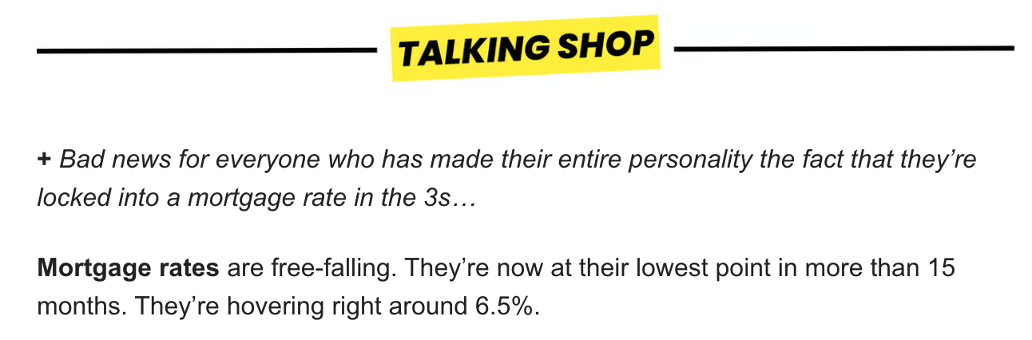
Problem Statement: Accurate prediction of household pricing is crucial as it serves as a leading indicator of economic health, influencing central bank policies and investment decisions.
Importance: Accurate prediction of household pricing is crucial as real estate represents a significant portion of national wealth, accounting for 15-18% of global GDP in 2021.
Need/Challenges: The housing market's sensitivity to various factors, such as regulatory changes and economic cycles, poses significant challenges to precise forecasting.
Implication: Effective prediction models can aid in risk management for investors and enhance government interventions to stabilize the economy during fluctuations.
https://www.nahb.org/news-and-economics/housing-economics/housings-economic-impact/housings-contribution-to-gross-domestic-product

Slide 5
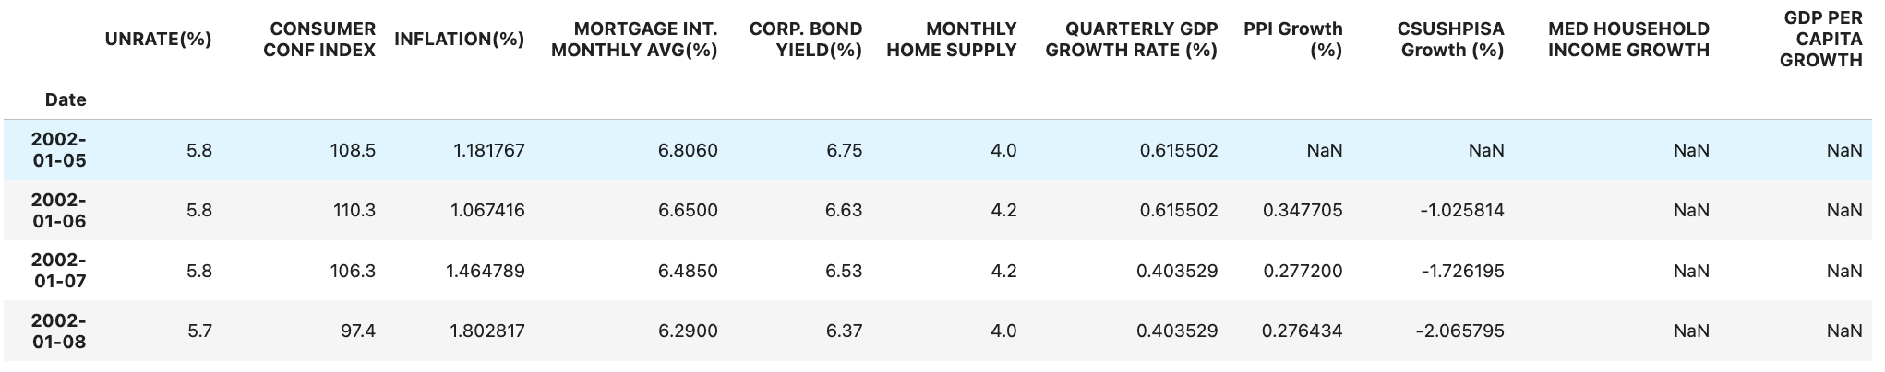
Dataset Overview: US Macro-Economic Factors data from 2002-2022
Dataset Structure - https://www.kaggle.com/datasets/sagarvarandekar/macroeconomic-factors-affecting-us-housing-prices
Sourced and compiled data from official websites of US government like FRED, CENSUS, OECD, Conference Board.
Total Records: The dataset contains month-wise records of various macroeconomic factors in the US from May 2002 to May 2022.
Example Features (there are 13 in total):
Unemployment Rate: Percentage of unemployed individuals in the labor force.
Consumer Confidence Index: A measure of consumer optimism about the economy.
Mortgage Interest Rate: Average monthly interest rate for mortgages.
Median Household Income: Average income of households.
Next Steps:
Part 1: Imputation of data, stationarity tests
Part 2: Correlation analysis, dimensional Reduction,
Part 3: Granger Causality, Mediator-Moderator Analysis

Slide 6
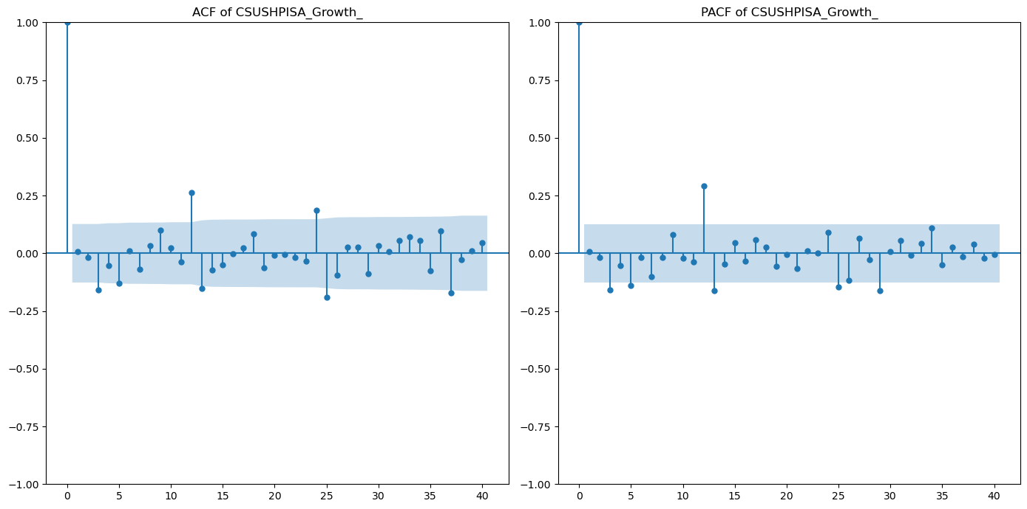
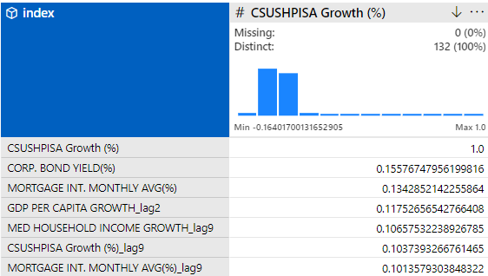
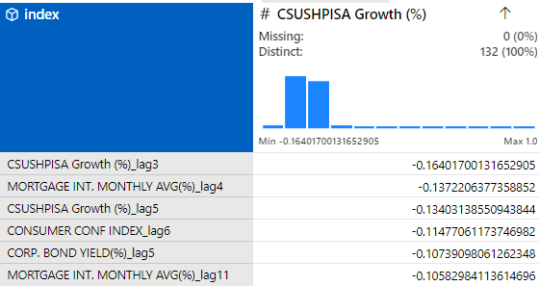
Autocorrelation and lag correlation
The time series nature of the House price index indicates autocorrelation and possibly stationality
Using lagged features will help to improve the accuracy of the model

Slide 7
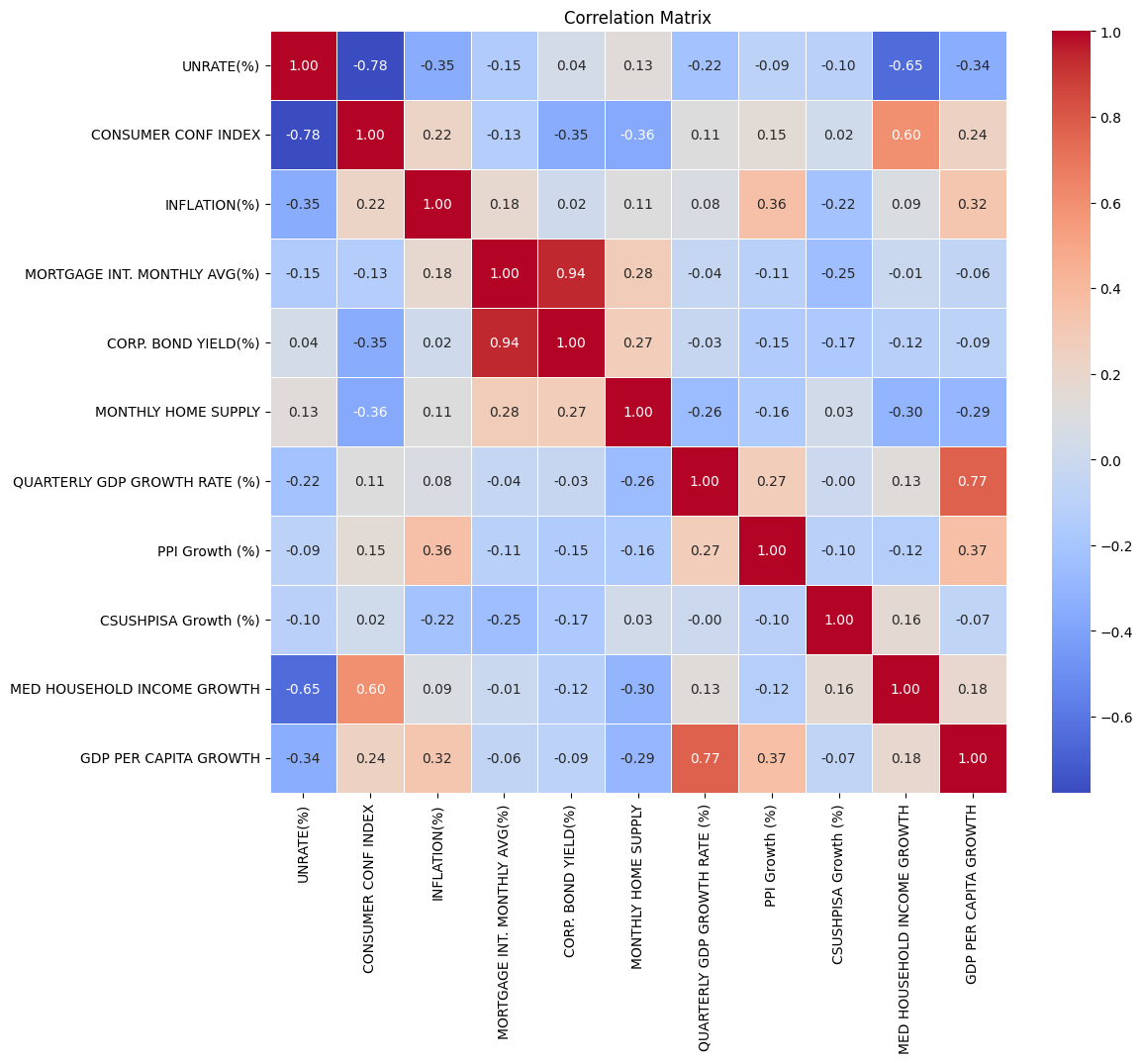
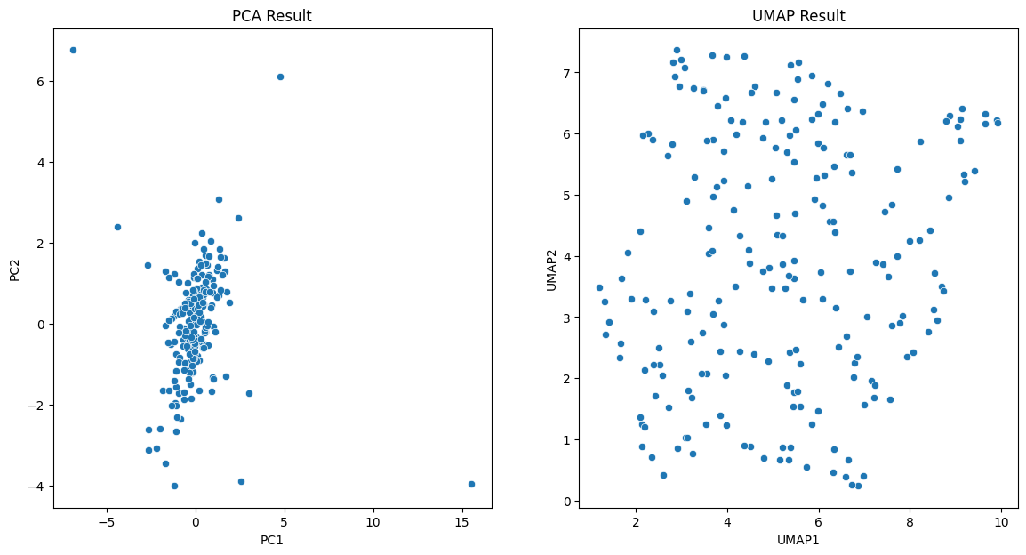
Correlation, Stationary, Dimension Reduction Tests didn’t return impactful results for modeling
Based on time series charts, mostly of the variables are stationary
No variable show high correlation with house pricing growth. However, multiple variables are highly correlated with each other, like mortgage monthly avg vs. corp bond yield, GDP per capita growth vs. quarterly GDP growth rate.
Dimension reduction tests, PCA and UMAP, didn’t return impactful result as the key components don’t appear to have distinct clusters

Slide 8
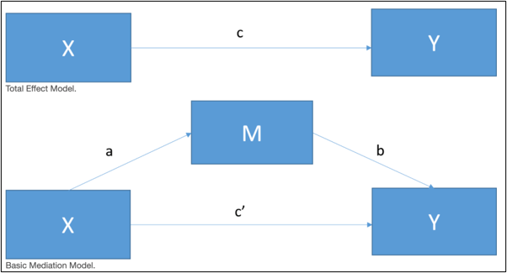
Analyzing Associations and Interaction Effects for the Variables
Granger Causality Test
PPI Growth (%): Significant predictive relationship at Lag 1 (p-value = 0.0257).
GDP Per Capita Growth: Some predictive potential at Lag 2 (p-value = 0.1639).
Consumer Confidence Index: Minimal predictive power (p-value = 0.2019).
Other Variables showed no predictive power.
Mediator/Moderator Analysis
We aim to understand the interaction effects between economic indicators and their influence on the house prices.
No Significant Mediation Effects in all permutations and combinations.
Need for AutoML: The complexity of the housing market and the lack of significant findings indicate the necessity for AutoML solutions to explore complex relationships and enhance prediction accuracy.
Note1: Mediator, an intermediary variable influenced by the independent variable and affecting the dependent variable (Baron & Kenny, 1986).
Note2: Moderator, a variable affecting the strength or direction of the relationship between an independent and a dependent variable, specifying the conditions under which this relationship changes (Baron & Kenny, 1986).
Notes:
jason

Slide 9
RMSE is a key metric in macroeconomic settings as it penalizes larger errors and provides a balanced measure of predictive accuracy.
Measures the average of the absolute differences between predicted and actual values.
Simple to interpret
May not capture the full range of error distributions.
Ideal for clear interpretation without bias from outliers.
Definition
Pros/Cons
Use Case
Mean Absolute Error (MAE)
Computes the average of the squared differences between predicted and actual values.
Penalize larger errors more
Units differ from the original data, complicating interpretation.
Highlights significant discrepancies, important for sensitive economic forecasting.
Definition
Pros/Cons
Use Case
Mean Squared Error (MSE)
The square root of the mean of the squared differences between predicted and actual values.
Maintains the same units as the original data; amplifies the impact of larger errors.
Offers a balanced measure of accuracy that penalizes significant errors while remaining interpretable, essential for accurate economic projections.
Root Mean Squared Error (RMSE)
Definition
Pros/Cons
Use Case
Notes:
jason

Slide 10

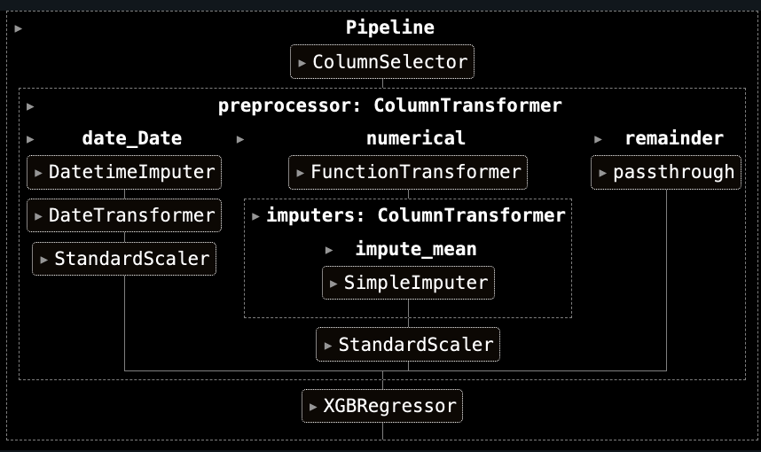
Build a pipeline using Databricks MLFlow to train a machine learning model using the train dataset (use AutoML to refine the category of algorithms).
Data Splitting:
Split dataset into training (60%), validation (20%), and test (20%) sets based on time order.
Feature Engineering:
Created lagged versions of the target variable to use as a new feature
Pipeline Creation:
Created a pipeline for validation dataset transformation and early stopping.
Included column selector and preprocessor.
Model Training with AutoML:
Defined the objective function for hyperparameter optimization with hyperopt.
Started an MLflow run, configured regressor with specific hyperparameters.
Enabled MLflow's autologging for inputs, metrics, parameters, and models.
Model Fitting and Early Stopping:
Trained the model on the training dataset.
Applied early stopping based on validation dataset performance.
Evaluation and Logging:
Evaluated and logged RMSE and other metrics for training, validation, and test sets using MLflow.
Hyperparameter Optimization:
Used hyperopt's fmin function with tpe.suggest algorithm to optimize hyperparameters.
Selected the best model based on validation RMSE.
Notes:
jason

Slide 11
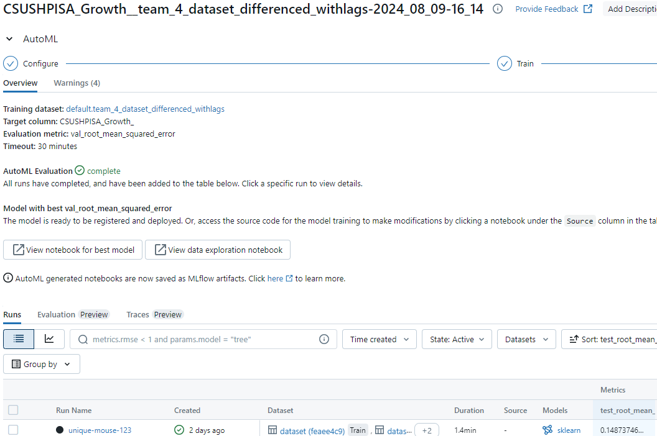
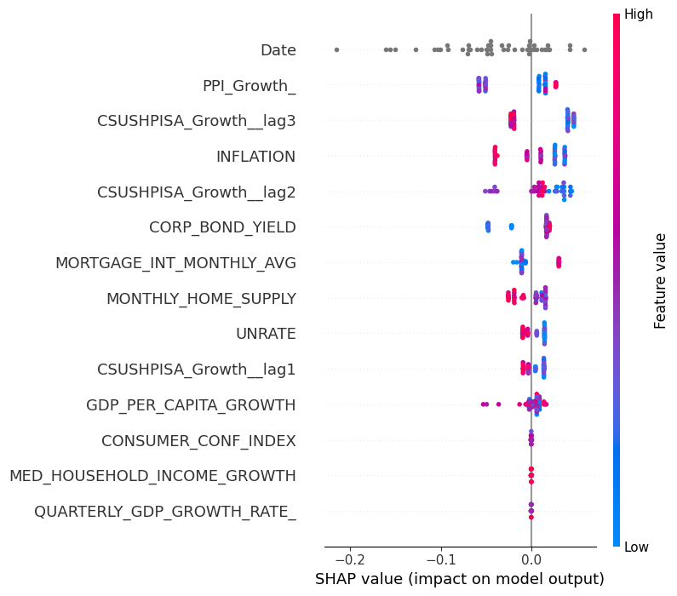
AutoML results and the chosen algorithm from Databricks
WINNING MODEL
SHAP Evaluation
Winning Model:
Model Type: XGBoost Regressor
Key Hyperparameters:
learning_rate: 0.4876
max_depth: 6
min_child_weight: 3
n_estimators: 2
subsample: 0.4610
colsample_bytree: 0.6866
Model Performance (RMSE):
Training RMSE: 0.1917
Validation RMSE: 0.2943
Test RMSE: 0.1650
Utilized Databricks’ Experiments - AutoML section - this is a no-code solution.
User inputs target column, evaluation metric, date column, timeout time.
Optimal model sorted by lowest RMSE.
Notes:
jason

Slide 12
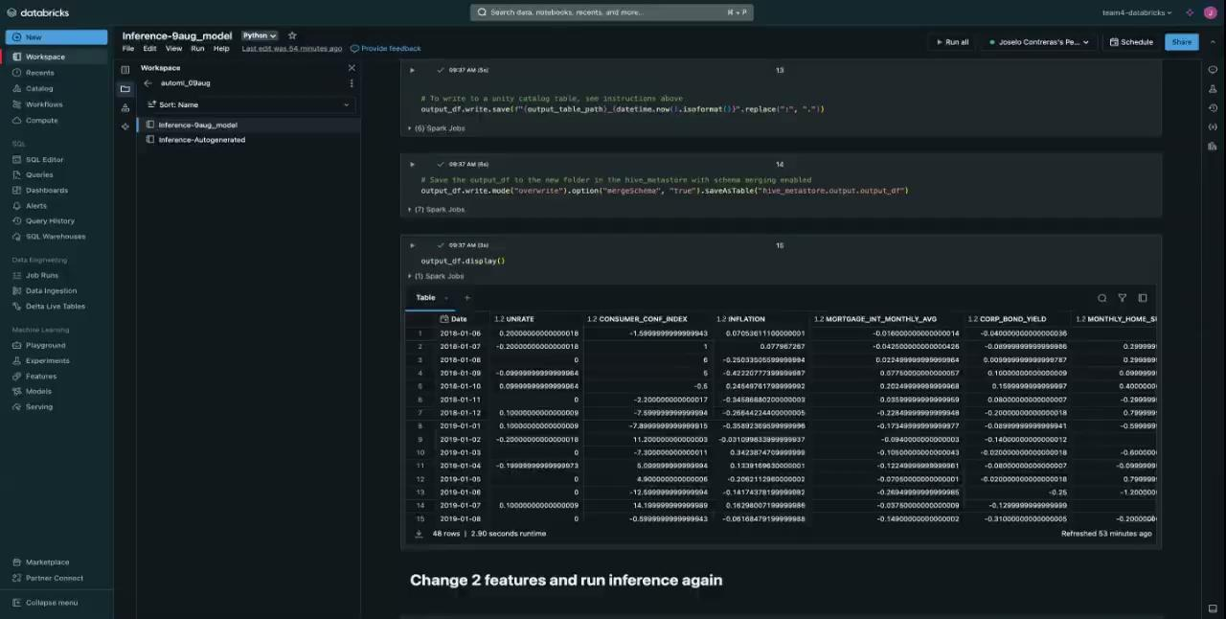
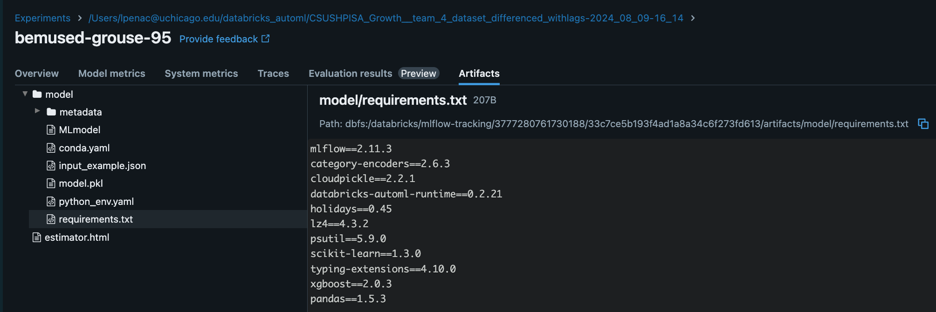
Deploying the model for inference
Batch Processing - We are using batch inference to apply our deployed model to large datasets in a single run.
Model Deployment: The model is loaded from MLflow using model_uri = f"models:/{model_name}/1", ensuring it's ready for inference with the correct environment.
Input Data Setup: Input data is loaded into a Spark DataFrame with table = spark.table(input_table_name), preparing the batch data for processing.
Running Inference: A Spark UDF is created for predictions using predict = mlflow.pyfunc.spark_udf(spark, model_uri, result_type="double"), and applied to the DataFrame with output_df = table.withColumn("prediction", predict(struct(*table.columns))).
Saving Predictions: The predictions are saved to the specified path with output_df.write.mode("overwrite").save(output_table_path), confirming successful inference.
Notes:
jason

Slide 13
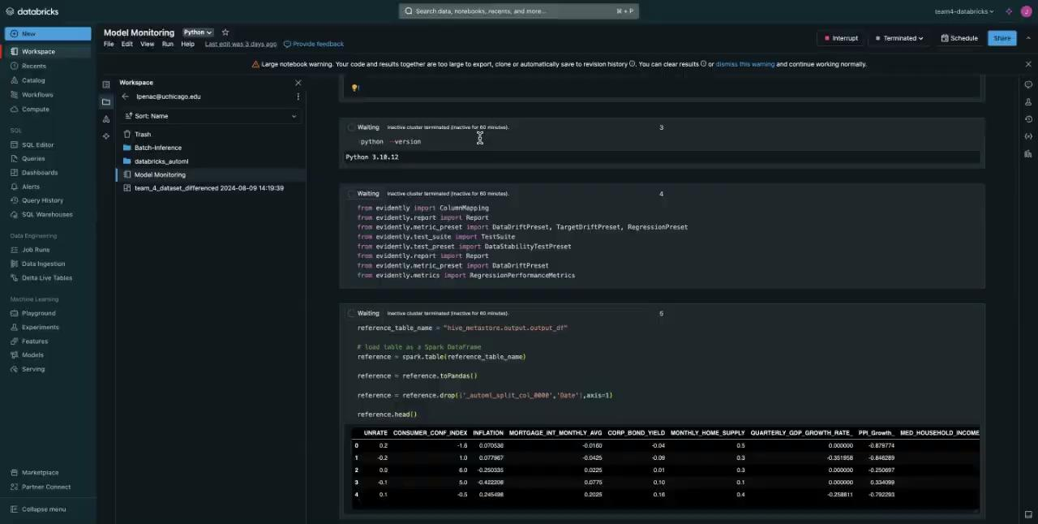
Video Demo: Using the test data with the deployed model and validate the results (metric) and model monitoring.
Running Model Evaluation with EvidentlyAI: Utilized the EvidentlyAI library to create a regression performance report.
Loading the Reference Data: Loaded the test dataset from the hive_metastore.output.output_df table into a Spark DataFrame; Model Performance Mapping: Defined the target variable (CSUSHPISA_Growth_) and the prediction column (prediction) to align with the model's output.
Monitoring Results: Executed the performance report, which confirmed that the test RMSE of 0.1650 was consistent with previous evaluations.
This validated that the deployed model maintained its performance in the test environment, ensuring reliability and accuracy.

Slide 14
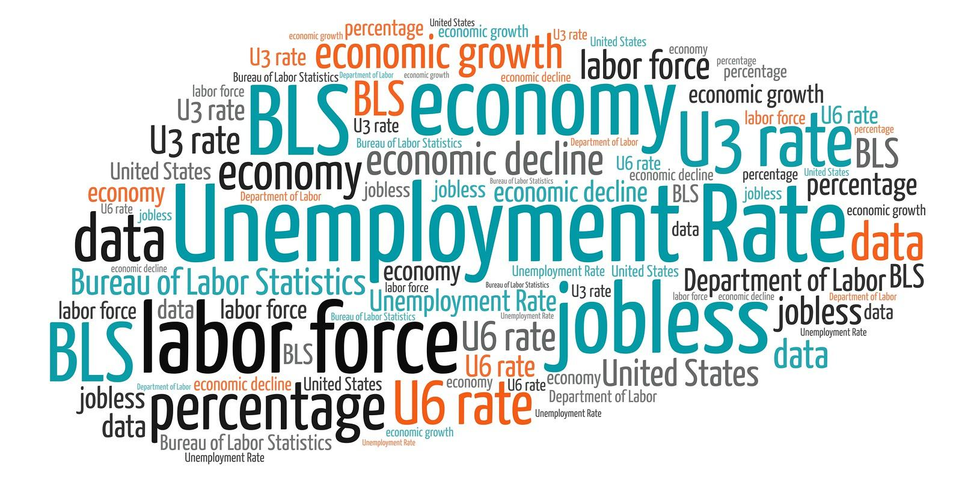
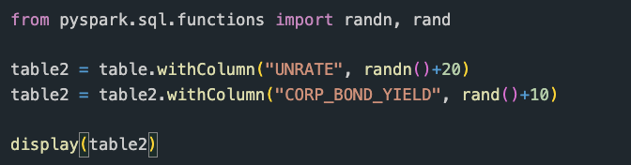
Change at least 2 feature values of the test dataset (you can put in random values or swap 2 features).
The Change in Dataset:
Replaced the "Unemployment Rate" column's values with random numbers from a normal distribution centered around 20.
Replaced the "Corporate Bond Yield" column's values with random numbers uniformly distributed between 10 and 11.

Slide 15
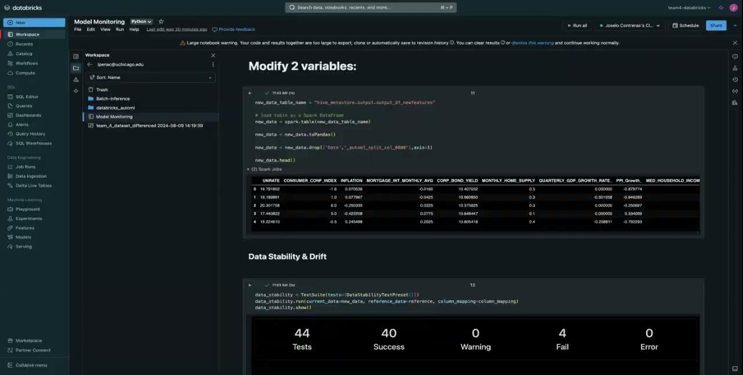
Video Demo (Part 1): Use the "changed" test data with the deployed model and validate the results (metric) and verify observation with model monitoring.
Data Drift & Monitoring
Data stability report and data drift input showcases drift detected for both ‘unemployment rate’ & ‘corporate bond’ yield.
Data stability:
Mean value stability and Out-of-range values flagged
Data drift:
‘unemployment rate’ & ‘corporate bond’ detected.
However, target variable drift not detected.

Slide 16
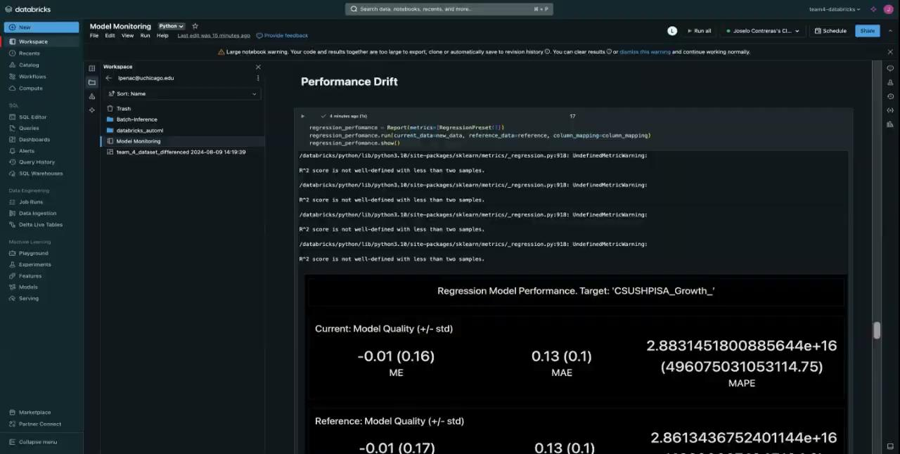
Video Demo (Part 2): Use the "changed" test data with the deployed model and validate the results (metric) and verify observation with model monitoring.
Metric
Increase in MAPE for the current model (2.88e+16) compared to the reference model (2.86e+16) -> Due to the shift.
Underestimation: The current model has slightly lower underestimation bias (-0.25) compared to the reference model (-0.28), indicating it tends to underestimate slightly less.
Overestimation: Both models have the same overestimation bias (0.39).

Slide 17



Conclusion and Learnings from Methodology
The Good:
Efficient Model Training: Using Databricks' AutoML streamlined the process of model selection and hyperparameter tuning, significantly reducing the time required to identify the best model.
Comprehensive Logging and Evaluation: MLflow provided robust tools for logging model metrics, parameters, and artifacts, ensuring traceability and reproducibility of the experiments.
The Learnings:
Databricks' Utility: Databricks proved to be a powerful platform for managing and scaling machine learning workflows, offering seamless integration with MLflow for model tracking and hyperparameter optimization.
The Future:
Real-time Monitoring: Implementing advanced model monitoring and alerting systems to continuously track model performance in production and detect potential drifts or anomalies.

Slide 18
Thank you!

